Slide 1



Myntra Product Analysis
Captured By Sapna B

Slide 2





Data Fetching
Data Cleaning & Preparation
Data Retrieval & Lookup
Data Analysis

Slide 3

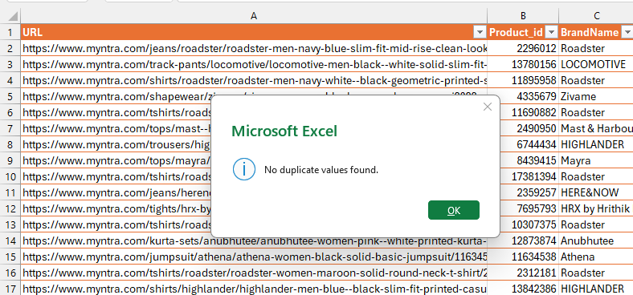
Data Cleaning & Preparation
Problem: Check for duplicate values in your dataset and remove them.
Solution: A thorough examination of the dataset was conducted to identify any duplicate entries. The analysis confirmed that no duplicates were present, ensuring the dataset’s accuracy and reliability for further processing..

Slide 4
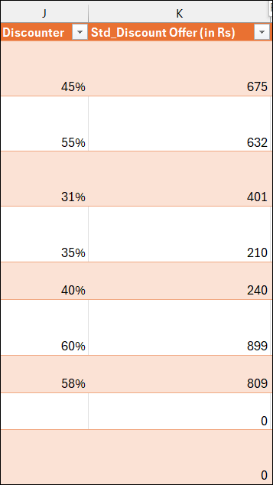
Data Cleaning & Preparation
Problem: Standardize the "DiscountOffer" column to a single format, ensuring all values are uniform.
Solution: Basically removed irrelevant text like "Off" and "Off Hurry!" to retain only the numeric portion of the discount.
The following Excel formula was applied to derive a clean numerical value:
Std_Discount_Offer =IF([@Discounter]<> "",
IF(ISNUMBER(SEARCH("Rs.", [@Discounter])), VALUE(SUBSTITUTE([@Discounter], "Rs. ", "")), [@[OriginalPrice (in Rs)]]*VALUE(SUBSTITUTE([@Discounter], "%", " "))), 0)

Slide 5
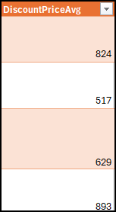
Data Cleaning & Preparation
Problem: Identify rows where both "DiscountPrice" and "DiscountOffer" are null and fill the "DiscountPrice" with the average discount price of the respective category.
=IF( AND(ISBLANK([@[DiscountPrice (in Rs)]]), [@[Std_Discount Offer (in Rs)]] = 0), IF( COUNTIFS(D:D, [@Category], I:I, "<>") > 0, ROUND(AVERAGEIFS(I:I, D:D, [@Category], I:I, "<>"), 0), "" ), [@[DiscountPrice (in Rs)]] )
Solutions:
Check if Discount Price is missing and Standard Discount Offer is zero:
ISBLANK([@[DiscountPrice (in Rs)]])
[@[Std_Discount Offer (in Rs)]] = 0
If both conditions are met:
Look for other non-blank discount prices within the same Category.
Use AVERAGEIFS to calculate the average of available prices in that category.
ROUND the average to the nearest whole number.
If conditions are not met:
Use the existing Discount Price from the row.

Slide 6
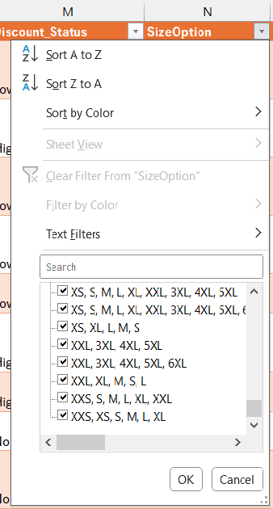

Data Cleaning & Preparation
Problem: Replace all null values in the "SizeOption" column with the text "Not Available."
Solution: A data filter was applied to the "SizeOption" column to identify any NULL (empty or missing) entries. After filtering, it was confirmed that no NULL values are present in the column. Therefore, no replacement was necessary as the data is already complete in this field.

Slide 7
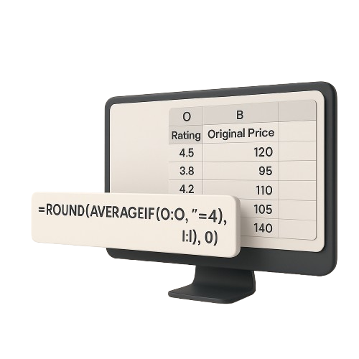
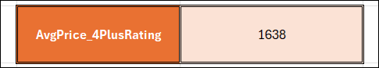
Data Analysis
Problem: Calculate the overall average original price for products with ratings greater than 4.
Solution: To solve this, we used the AVERAGEIF function in Excel to filter and calculate the required value:
AvgPrice_4PlusRating=ROUND(AVERAGEIF(O:O, ">=4", I:I), 0)
O:O refers to the column containing product ratings.
I:I refers to the column with the original prices.
The formula calculates the average original price only for products with a rating greater than or equal to 4.
The ROUND(..., 0) function is used to round the result to the nearest whole number for cleaner presentation.

Slide 8
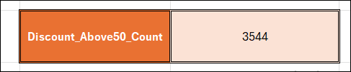
Data Analysis
Problem: Count the number of products with a discount offer greater than 50% OFF.
Solutions: We use the COUNTIF function in Excel to count how many products have a discount value greater than or equal to 50% (i.e., >= 0.5).
Discount_Above50_Count=COUNTIF(K:K,">=0.5")
Explanation:
K:K refers to the column containing the discount percentage for each product (in decimal form, e.g., 0.50 for 50%).
The formula counts how many rows in column K have values greater than or equal to 0.5, indicating products with more than 50% discount.

Slide 9
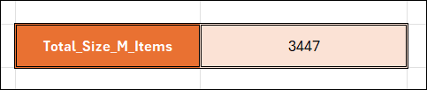
Data Analysis
Problem: Count the number of products available in size "M."
Solution: We use the COUNTIF function in Excel to count the number of entries in the dataset where size "M" is mentioned.
=COUNTIF(O:O, "*M*")
O:O is the column containing size information (e.g., "S", "M", "L", or combinations like "S,M,L").
"*M*" looks for any cell that contains "M" (regardless of whether it's alone or part of a group).
The formula returns the total count of products where size "M" is available.

Slide 10
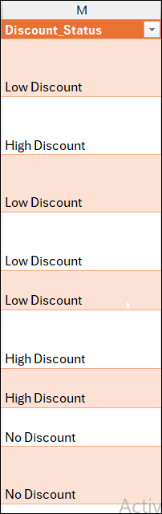
Data Analysis
Problem: Create a new column to label the products as "High Discount" if the discount offer is greater than 50% OFF, otherwise label them as "Low Discount."
Solution: Discount Status We will use an IF formula in Excel to derive the new label based on the discount value in the Discounter column.
Formula (for the column: Discount_Status):
=IF(NOT(ISBLANK([@Discounter])),
IF([@Discounter]>=50%, "High Discount", "Low Discount"),
"No Discount")
NOT(ISBLANK([@Discounter])): Checks if the discount cell is not empty.
IF([@Discounter]>=50%, "High Discount", "Low Discount"): Applies the discount logic.
If the discount is blank or null, it assigns “No Discount”.

Slide 11
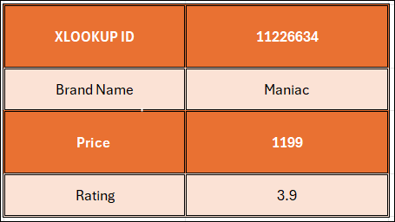
Data Retrieval and Lookup
Problem: Use VLOOKUP/XLOOKUP to find the product brand, price, and rating of the product with Product_id "11226634".
Solution: We will use the XLOOKUP function to find and return the respective details for the product with Product ID "11226634" stored in cell V6
Retrieve Brand Name:
=XLOOKUP(V6, B:B, C:C)
This returns the brand name from column C by matching the Product ID in column B.
Retrieve Price:
=XLOOKUP(V6, B:B, I:I)
This returns the price of the product from column I.
Retrieve Rating:
=XLOOKUP(V6, B:B, O:O)
This returns the customer rating from column O

Slide 12
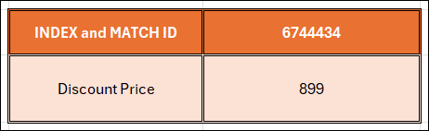
Data Retrieval and Lookup
Problem: Find the "DiscountPrice" for the product with the Product ID "6744434" using the INDEX and MATCH functions.
Solution: We will use a combination of INDEX and MATCH to retrieve the Discount Price and round it to the nearest whole number.
=ROUND(INDEX(K:K, MATCH(V12, B:B, 0)), 0)
Explanation:
MATCH(V12, B:B, 0) finds the row number where the Product ID in cell V12 (which is "6744434") matches the Product ID in column B.
INDEX(K:K, ...) retrieves the DiscountPrice from column K based on the row found by MATCH.
ROUND(..., 0) rounds the result to the nearest whole number for a cleaner presentation.
This formula ensures accuracy and flexibility in pulling data from non-adjacent columns.

Slide 13
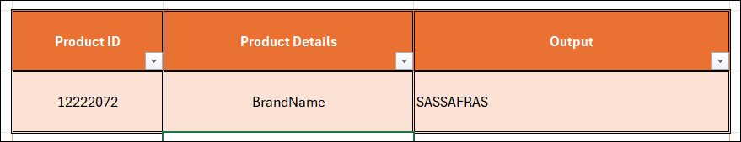
Data Retrieval and Lookup
Problem: Utilize nested xlookup to find any column’s detail of a product with it’s product id.
Solution: We use nested XLOOKUP to first locate the product row using the Product ID and then look up the desired column name dynamically.
= XLOOKUP( TRIM(Y3), TRANSPOSE(A1:P1), TRANSPOSE(XLOOKUP( X3, B2:B5160, A2:P5160,"Not Found")),"Not Found")
X3: Contains the Product ID to search for.
Y3: Contains the Column Name the user wants to retrieve (e.g., “Brand”).
The inner XLOOKUP finds the full product row based on the Product ID.
The outer XLOOKUP locates the correct column value based on the column name entered.
TRANSPOSE is used to align data orientation between the header and the result row..

Slide 14
Thank You
Mentor: Ayushi Jain

